Slide 1
Java Collections

Slide 2
What n Why a Collection?
What?
  Is simply an object that groups multiple elements into a single unit
Why?
  store, retrieve, manipulate, and communicate aggregate data

Slide 3
Benefits of Collection Framework
  Reduces programming effort
  Increases program speed and quality
  Allows interoperability among unrelated APIs
    The collection interfaces are the vernacular by which APIs pass collections back and forth
  Reduce effort to learn and use new APIs
  Reduces effort to design new APIs

Slide 4
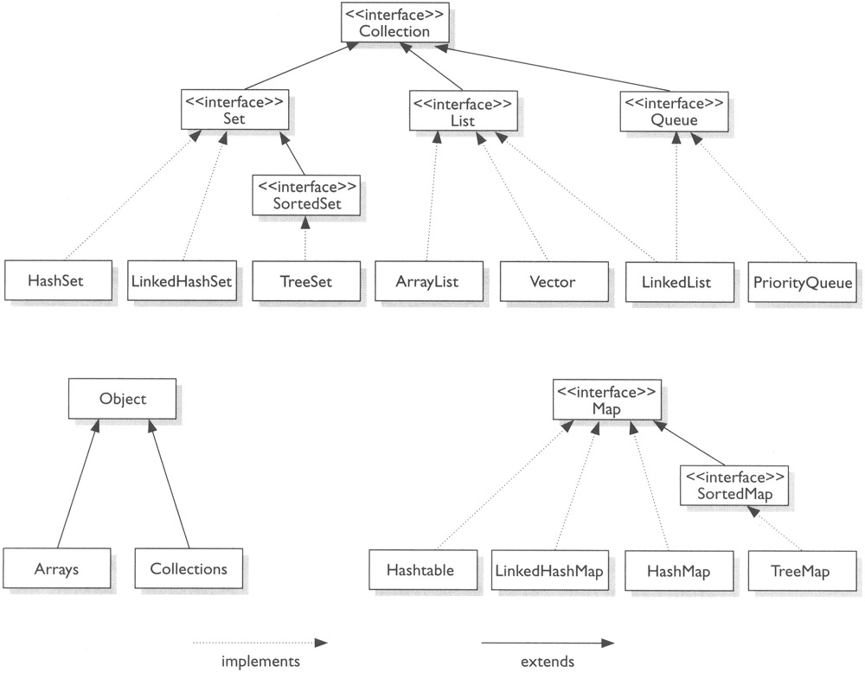
The Java Collections Framework

Slide 5
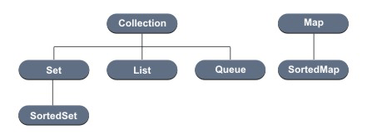
Collection Interfaces
Collections are primarily defined through a set of interfaces
  Supported by a set of classes that implement the interfaces

Slide 6
Collection Interfaces (Contd.)
Interfaces are used of flexibility reasons
  Programs that uses an interface is not tightened to a specific implementation of a collection
  It is easy to change or replace the underlying with another (more efficient) class that implements the same interface

Slide 7
Collection Interface
The root of the collection hierarchy
Is the least common denominator that all collection implement
  Every collection object is a type of Collection interface
Is used to pass collection objects around and to manipulate them when maximum generality is desired
JDK doesn’t provide any direct implementations of this interface but provides implementations of more specific subinterfaces, such as Set and List

Slide 8
Collection Interface (Contd.)
public interface Collection<E> extends Iterable<E> {
//Basic Operations
int size();
boolean isEmpty();
boolean contains(Object element);
boolean add(E element); //optional
boolean remove(Object element); //optional
Iterator<E> iterator();
//Bulk Operations
boolean containsAll(Collection<?> c);
boolean addAll(Collection<? extends E> c); //optional
boolean removeAll(Collection<?> c); //optional
boolean retainAll(Collection<?> c); //optional
void clear(); //optional
//Array Operations
Object[] toArray();
<T> T[] toArray(T[] a);
}

Slide 9
Collection Interface (Contd.)
The add() method is defined generally enough so that it makes sense for collections that allow duplicates as well as those that don’t
It guarantees that the Collection will contain the specified element after the call completes, and returns true if the Collection changes as a result of the call
  add() method of Set interface follows “no duplicate” rule
for-each:
  The for-each construct allows you to concisely traverse a collection or array using a for loop
  for (Object o : collection)
    System.out.println(o);

Slide 10
The Iterator interface
An Iterator is an object that enables through a collection and to remove elements from the collection selectively, if desired
fail-fast – Exception thrown if collection is modified externally, i.e., not via the iterator (multi-threading)
public interface Iterator {
boolean hasNext();
Object next(); //Note – one way
void remove(); //optional
}

Slide 11
The Iterator Interface (contd.)
hasNext() returns true if the iteration has more elements
next() method returns the next element in the iteration
remove() is the only safe way to modify a collection during iteration; the behavior is unspecified if the underlying collection is modified in any other way while the iteration is in progress
  When called and supported, the element returned by the last next() call is removed
  The for-each construct hides the iterator, so you cannot call remove; so for-each not usable for filtering

Slide 12
The Iterator Interface (contd.)
Example:
  Collection collection = …;
  Iterator iterator = collection.iterator();
  while (iterator.hasNext()) {
  Object element = iterator.next();
  if (removalCheck(element))
  iterator.remove();
  }

Slide 13
Collection Interface: Bulk Operations
containsAll() – returns true if the target collection contains all of the elements in the specified collection
addAll() – adds all of the elements in the specified collection to the target collection
removeAll() – removes from the target collection all of its elements that are also contained in the specified collection
retainAll() – retains only those elements in the target collection that are also contained in the specified collection
  Kind of like intersection
clear() – removes all elements from the collection

Slide 14
The Set Interface
Corresponds to the mathematical definition of a set (no duplicates are allowed)
Compared to the Collection interface:
  Interface is identical
  Every constructor must create a collection without duplicates
  The operation add cannot add an element already in the set

Slide 15
The Set Interface (Contd.)
Set Idioms
  set1 ∪ set2 – set1.addAll(set2)
  set1 ∩ set2 – set1.retainAll(set2)
  set1 – set2 – set1.removeAll(set2)
equals operation – Set also adds a stronger contract on the behavior of the equals and hashCode operations, allowing Set instances to be compared meaningfully even if their implementation types differ
  Two Set instances are equal if they contain the same elements
Implementations of Set interface – HashSet, TreeSet, and LinkedHashSet

Slide 16
HashSet
Implemented using a hash table
No ordering of elements
add, remove, and contains methods constant time complexity O(c)
Iteration is linear in the sum of the number of entries and its capacity
  Choosing an initial capacity that’s too high can waste both space and time
  Choosing an initial capacity that’s too low wastes time by copying the data structure each time it’s forced to increase its capacity

Slide 17
HashSet (Contd.)
import java.util.*;
public class FindDups {
public static void main(String args[]) {
Set s = new HashSet();
for (int i=0; i<args.length; i++)
if (!s.add(args[i]))
System.out.println(“Duplicate detected : ” + args[i]);
System.out.println(s.size() + “ distinct words detected : ” + s);
}
}

Slide 18
LinkedHashSet
Implemented as a hash table with a linked list running through it
Provides insertion-ordered iteration (least recently inserted to most recently) and runs nearly as fast as HashSet
Spares its clients from the unspecified, generally chaotic ordering provided by HashSet without incurring the increased cost associated with TreeSet

Slide 19
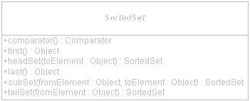
SortedSet Interface
A Set that maintains its elements in ascending order
Several additional operations are provided to take advantage of the ordering
Sorted sets are used for naturally ordered sets, such as word lists and membership roll

Slide 20
SortedSet Interface (Contd.)
Provides access to ends of the set as well as to subsets of the set
Changes to the subset are reflected in the source set and vice-versa i.e., changes in the source set are reflected in the subset
Elements added to a SortedSet must either implement Comparable or you must provide a Comparator to the constructor of its implementation class: TreeSet

Slide 21
TreeSet
Implemented using a tree structure
Guarantees ordering of elements
add, remove, and contains methods logarithmic time complexity O(log(n)), where n is the number of elements in the set
Used when there is a need to use the operations in the SortedSet interface, or if value-ordered iteration is required

Slide 22
TreeSet (Contd.)
Set ts = new TreeSet();
ts.add(“one”);
ts.add(“two”);
ts.add(“three”);
ts.add(“four”);
System.out.println(“Members of the TreeSet : ” + ts);
Output—
Members of the TreeSet : [four, one, three, two]

Slide 23
List Interface
An ordered collection (sometimes called a sequence)
Lists can contain duplicate elements
The user of a list generally has precise control over where in the list each element is inserted and can access elements by their integer index (position)

Slide 24
List Interface (Contd.)
Additional operations supported by List interface over Collection:
  Positional Access – manipulates elements based on their numerical position in the list
  Search – searches for a specified object in the list and returns its numerical position
  Iteration – extends Iterator semantics to take advantage of the list’s sequential nature
  Range-view – performs arbitrary range operations on the list

Slide 25
List Interface (Contd.)
Further requirements compared to the Collection interface:
  add(Object) – Adds at the end of the list
  remove(Object) – Removes at the start of the list
  list1.equals(list2) – The ordering of the elements is taken into consideration
  hashCode – Extra requirements to this method
    list1.equals(list2) implies that list1.hashCode()==list2.hashCode()

Slide 26
List Interface (Contd.)
public interface List<E> extends Collection<E> {
//Positional access
E get(int index);
E set(int index, E element); //optional
boolean add(E element); //optional
void add(int index, E element); //optional
E remove(int index); //optional
boolean addAll(int index, Collection<? extends E> c); //optional
//Search
int indexOf(Object o);
int lastIndexOf(Object o);
//Iteration
ListIterator<E> lsitIterator();
ListIterator<E> listIterator(int index);
//Range-view
List<E> subList(int from, int to);
}

Slide 27
ListIterator Interface
ListIterator extends Iterator
  boolean hasNext(); Object next();
  boolean hasPrevious(); Object previous();
  int nextIndex(); int previousIndex();
  void remove(); void set(Object o); void add(Object o) – All three optional
The ListIterator is originally positioned beyond the end of the list i.e. list.size(), as the index of the first element is 0
Example:
List list = …;
ListIterator iterator = list.listIterator(list.size());
while (iterator.hasPrevious()) {
Object element = iterator.previous
//Process element
}

Slide 28
ListIterator Interface (Contd.)
Normally, ListIterator is not used to alternate between going forward and backward in one iteration through the elements of a collection, though technically possible
add() – Adding an element results in the new element being added immediately prior to the implicit cursor
  calling previous() after adding an element would return the new element
  calling next would have no effect after adding an element

Slide 29
Range-view of List Interface
subList():
  Element at fromIndex is in the sublist, element at toIndex is not
  Loosely maps to the following for-loop:
  for (int i=fromIndex; i<toIndex; i++)
Changes to the sublist (like add(), remove() and set() calls) have an effect on the underlying list

Slide 30
ArrayList
Is an array based implementation where elements can be accessed directly via the get and set methods
  Default choice for simple sequence
  Offers constant-time positional access
  Fast
  Think of ArrayList as Vector without synchronization overhead
  Use it if you need to support random access, without inserting or removing elements from any place other than the end

Slide 31
LinkedList
LinkedList is based on a double linked list
  Gives better performance on add and remove compared to ArrayList
  Gives poorer performance on get and set methods compared to ArrayList
  Use it if you need to frequently add and remove elements from the middle of the list and only access the list elements sequentially

Slide 32
LinkedList (Contd.)
New methods of LinkedList:
  void addFirst(element : Object);
  void addLast(element : Object);
  Object getFirst();
  Object getLast();
  Object removeFirst();
  Object removeLast();
Using these methods, it can be treated as a stack, or queue, or other end-oriented data structure
  LinkedList as queue – Use addFirst() and removeLast() methods
  LinkedList as stack – Use addLast() and removeFirst() methods

Slide 33
ArrayList and LinkedList Example
List arrList = new ArrayList();
arrList.add(“Naren”);
arrList.add(“Uday”);
arrList.add(“Suresh”);
arrList.add(“Bharath”);
arrList.add(“Naren”);
System.out.println(arrList);
System.out.println(“1 : ” + arrList.get(1));
System.out.println(“0 : ” + arrList.get(0));
LinkedList queue = new LinkedList();
queue.addFirst(“Naren”);
queue.addFirst(“Uday”);
queue.addFirst(“Suresh”);
queue.addFirst(“Bharath”);
queue.addFirst(“Naren”);
System.out.println(queue);
queue.removeLast();
queue.removeLast();
System.out.println(queue);

Slide 34
The Map Interface
Maps keys to values, handles key/value pairs
A Map cannot contain duplicate keys; each key can map to atmost one value
Methods for adding and deleting:
  put(Object key, Object value)
  remove(Object key)
Methods for extraction objects:
  get(Object key)
Methods to retrieve the keys, the values, and (key, value) pairs:
  keySet() //returns a Set
  values() //returns a Collection
  entrySet() //returns a Set

Slide 35
The Map Interface (Contd.)
public interface Map<K,V>
//Basic operations
V put(K key, V value);
V get(Object key);
V remove(Object key);
boolean containsKey(Object key);
boolean containsValue(Object value);
int size();
boolean isEmpty();
//Bulk operations
void putAll(Map<? extends K, ? extends V> m);
void clear();

Slide 36
The Map Interface (Contd.)
//Collection Views
public Set<K> keySet();
public Collection<V> values();
public Set<Map.Entry<K,V>> entrySet();
//Interface for entrySet elements
public interface Entry {
K getKey();
V getValue();
V setValue(V value);
}

Slide 37
Implementations of the Map Interface
HashMap
  Implementation is based on a hash table
  Use it if you want maximum speed and don’t care about iteration order
  Most commonly used implementation
TreeMap
  Implementation is based on red-black tree structure
  Use it when you need SortedMap operations or key-ordered Collection-view iteration
LinkedHashMap
  Use it if you want near–HashMap performance and insertion-order iteration

Slide 38
Queue Interface
A collection used to hold multiple elements prior to processing
Besides basic Collection operations, a Queue provides additional insertion, extraction, and inspection operations
Typically, but do not necessarily, order elements in a FIFO (first-in, first-out) manner
Also check Deque interface which is a sub-interface of Queue
  It’s a Queue which can be used both forwards or backwards, or both at once
  Implementations – ArrayDeque and LinkedList

Slide 39
Implementations of Queue Interface
LinkedList
  You already know
ArrayDeque
  Resizable-array implementation of the Deque interface
  No capacity restrictions, not thread-safe in the absence of external synchronization
  Null elements prohibited
  Faster than Stack when used as stack, and faster than LinkedList when used as a queue

Slide 40
Implementations of Queue Interface (Contd.)
PriorityQueue
  PriorityQueue class is a priority queue based on the heap data structure
  This queue orders elements according to an order specified at construction time, which can be the elements’ natural ordering or the ordering imposed by an explicit Comparator

Slide 41
Static Methods on Collections
Search and sort:
  int binarySearch(List list, Object key);
  int binarySearch(List list, Object key, Comparator c);
  void sort(List list);
  void sort(List list, Comparator c);
Reorganization:
  void reverse(List list);
  shuffle(List list);
  shuffle(List list, Random rnd);

Slide 42
Static Methods on Collections (Contd.)
Wrappings:
  Collection unmodifiableCollection(Collection c);
  List unmodifiableList(List list);
  Map unmodifiableMap(Map m);
  Set unmodifiableSet(Set s);
  SortedMap unmodifiableSortedMap(SortedMap m);
  SortedSet unmodifiableSortedSet(SortedSet s)
  Similar to all unmodifialbe, synchronized methods too
    Ex : synchronizedCollection(Collection c);
    Similarly with List, Map, Set, SortedMap, and SortedSet

Slide 43
Static Methods on Collections (Contd.)
Others:
  void copy(List dest, List src);
  Enumeration enumeration(Collection c);
  void fill(List list, Object obj);
  int indexOfSubList(List source, List target);
  int lastIndexOfSubList(List source, List target);
  ArrayList list(Enumeration e);
  Object max(Collection coll);
  Object max(Collection coll, Comparator comp);
  Object min(Collection coll);
  Object min(Collection coll, Comparator comp);
  List nCopies(int n, Object o); //Immutable List
  boolean replaceAll(List list, Object oldVal, Object newVal);
  Comparator reverseOrder();
  Set singleton(Object o); //Immutable set returned
  List singletonList(Object o); //Immutable
  Map singletonMap(Object key, Object value); //Immutable

Slide 44
Abstract Classes
Includes abstract implementations
  AbstractCollection
  AbstractSet
  AbstractList
  AbstractSequentialList
  AbstractMap
To aid in custom implementations
  Reduces code you have to write

Slide 45
Historical Collection Classes
Arrays
Vector
Stack
Enumeration Interface
Hashtable
Properties

Slide 46
Arrays
Fixed-size collections of the same datatype
Only collection that supports storing primitive datatypes
You specify both the number and type of object you wish to store while creation
It can neither grow nor store a different type (unless it extends the first type)
Size – array.length
Accessing beyond either end of the array will throw ArrayIndexOutOfBoundsException at runtime

Slide 47
Arrays (Contd.)
When created, arrays are automatically initialized, either to false for a boolean array, null for an Object array, or the numerical equivalent of 0 for everything else
To make a copy of an array, perhaps to make it larger, use arraycopy() method of System
  System.arraycopy(Object sourceArray, int sourceStartPosition, Object destinationArray, int destinationStartPosition, int length)
Helper class – java.util.Arrays
  Search and sort – binarySearch(), sort()
  Comparison – equals()
  Instantiation – fill()
  Conversion – asList()

Slide 48
Vector and Stack
Vector acts like a growable array, but can store heterogeneous dataelements
Instead, use ArrayList
Stack class extends Vector to implement LIFO with push() and pop() methods
  Still, you can access or modify a Stack with the inherited Vector methods

Slide 49
Enumeration Interface
Allows you to iterate through all the elements of a collection
Enumeration:
  boolean hasMoreElements();
  Object nextElement();
No removal support

Slide 50
Hashtable and Properties
Hashtable – Permits storing any object as its key or value (besides null)
  Similar to HashMap
  If synchronized Map is needed, using Hashtable is slightly faster than using a synchronized HashMap
Properties – Specialized Hashtable for working with text strings
  While you have to cast values retrieved from a Hashtable to your desired class, the Properties class allows you to get text values without casting
  Supports loading and saving property settings from an input stream or to an output stream
  Similar to TreeMap

Slide 51
Algorithms
Sorting
Shuffling
Routine data manipulation
Searching
Composition
Find extreme values

Slide 52
Algorithms (Contd.)
Provided as static methods of Collections class
The first argument is the collection on which the operation is to be performed
The majority of the algorithms provided by the Java platform operate on List instances, but a few of them operate on arbitrary Collection instances

Slide 53
Sorting
The sort algorithm reorders a List so that its elements are in ascending order according to an ordering relationship
Two forms of the operations
  Takes a List and sorts it according to its elements’ natural ordering
  Takes a Comparator in addition to a List and sorts the elements with the Comparator

Slide 54
Natural Ordering
The type of the elements in a List already implements Comparable interface
Examples:
  If the List consists of String elements, it will be sorted into alphabetical order
  If it consists of Date elements, it will be sorted into chronological order
  String and Date both implement the Comparable interface
If you try to sort a list, the elements of which do not implement Comparable, Collections.sort(list) will throw a ClassCastException

Slide 55
Sorting by Natural Order of List
String n[] = {
new String(“One”);
new String(“Two”);
new String(“Three”);
new String(“Four”);
}
List l = Arrays.asList(n);
Collections.sort(l);
Output – [Four, One, Three, Two]

Slide 56
Sorting by Comparator Interface
A comparison function, which imposes a total ordering on some collection of objects
Comparators can be passed to a sort method (such as Collections.sort or Arrays.sort) to allow precise control over the sort order
Comparators can also be used to control the order of certain data structures (such as sorted sets or sorted maps), or to provide an ordering for collections of objects that don’t have a natural ordering

Slide 57
Sorting by Natural Order of List
ArrayList arrList = new ArrayList();
arrList.add(“One”);
arrList.add(“Two”);
arrList.add(“Three”);
arrList.add(“Four”);
Comparator comp = Comparators.stringComparator();
Collections.sort(arrList, comp);
System.out.println(arrList);

Slide 58
Shuffling
The shuffle algorithm does the opposite of what the sort does, destroying any trace of order that may have been present in a List
  That is, this algorithm reorders the List based on input from a source of randomness such that all possible permutations occur with equal likelihood, assuming a fair source of randomness
Useful in implementing games of chance
  Could be used to shuffle a List of card objects representing a deck
  Generating test cases

Slide 59
Routine Data Manipulation
The Collections class provides five algorithms for doing routine data manipulation on List objects
  reverse – reverses the order of the elements in a list
  fill – overwrites every element in a List with the specified value. This operation is useful for reinitializing a List
  copy – takes two arguments, a destination List and a source List, and copies the elements of the source into the destination, overwriting its contents
    The destination List must be atleast as long as the source
    If it is longer, the remaining elements in the destination List are unaffected
  swap – swaps the elements at the specified positions in a List
  addAll – adds all the specified elements to a Collection
    The elements to be added may be specified individually or as an array

Slide 60
Searching
The Collections class has binarySearch() method for searching a specified element in a sorted List
    String n[] = {
    new String(“One”);
    new String(“Two”);
    new String(“Three”);
    new String(“Four”);
    }
    List l = Arrays.asList(n);
    int position = Collections.binarySearch(l, “One”);
    System.out.println(“Position of the searched item = ” + position);

Slide 61
Composition
Collections.frequency(l,el) – counts the number of times the specified element occurs in the specified collection
Collections.disjoint(l1, l2) – determines whether two collections are disjoint; i.e., whether they contain no elements in common

Slide 62
Good Bye Slide
Use the new collections in your new work
Tell your friends who still use Vector and Hashtable to get a life!!

Slide 63

Dedicated to this guy!

Slide 64

Chillaxxx! Its over, finally!!
ENJOY!!!

